Slide 1


ACCT 2003 Intermediate Financial Accounting 中级财务会计
THE HITSZ
SCHOOL OF ECONOMICS
AND MANAGEMENT
授课人：墙伟
2024.9.02

Slide 2


多选题
1分
Cryptocurrency
What about cryptocurrencies, such as Bitcoin?
A
Cash and Cash equivalent
B
Intangible Assets
C
Inventory
D
Investment
Submit
Notes:
. Cryptocurrency—despite its name—is not accounted for as currency and is not included in cash and cash equivalents.

Slide 3

LEARNING OBJECTIVES
CHAPTER 8
Valuation of Inventories: A Cost-Basis Approach
After studying this lecture, you should be able to:
Describe inventory classifications and different inventory systems.
Identify the goods and costs included in inventory.
Notes:
Inventories are of particular importance to merchandising and manufacturing companies because they represent the primary source of revenue for the organization. Inventories are also significant because of their impact on both the statement of financial position and the income statement.

Slide 4
LEARNING OBJECTIVE 1
Describe inventory classifications and different inventory systems.

Slide 5
Inventory Issues
Classification
Inventories are asset:
items held for sale in the ordinary course of business, or
goods to be used in the production of goods to be sold.
Businesses with Inventory
Merchandising Company
Manufacturing Company
or
LO 1
Notes:
(L.O. 1) Inventories are asset items that a company holds for sale in the ordinary course of business or goods that will be used or consumed in the production of goods to be sold. Merchandise inventory refers to the goods held for resale by a merchandising company. The inventory of a manufacturing firm is composed of three separate items: raw materials, work in process, and finished goods.

Slide 6
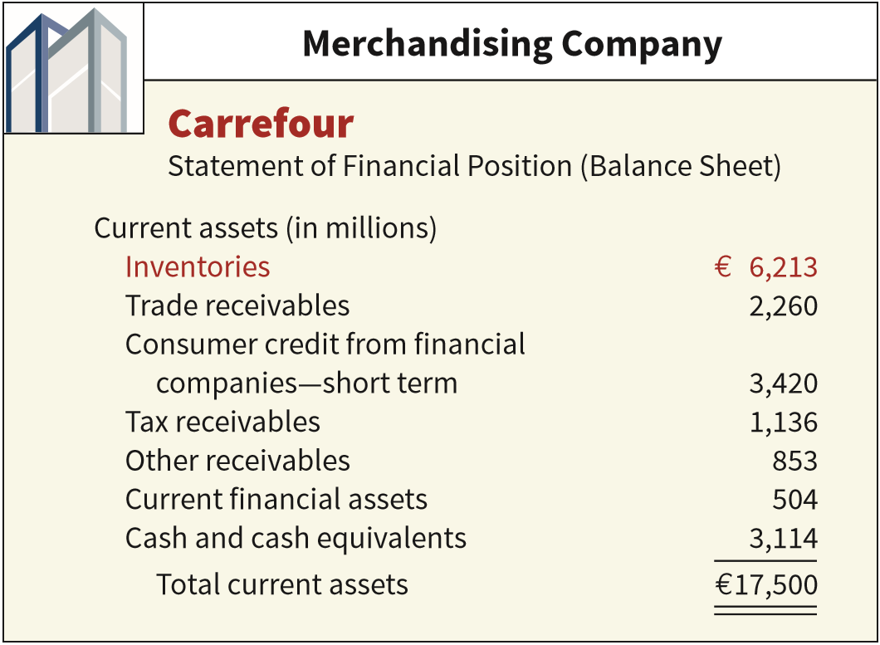
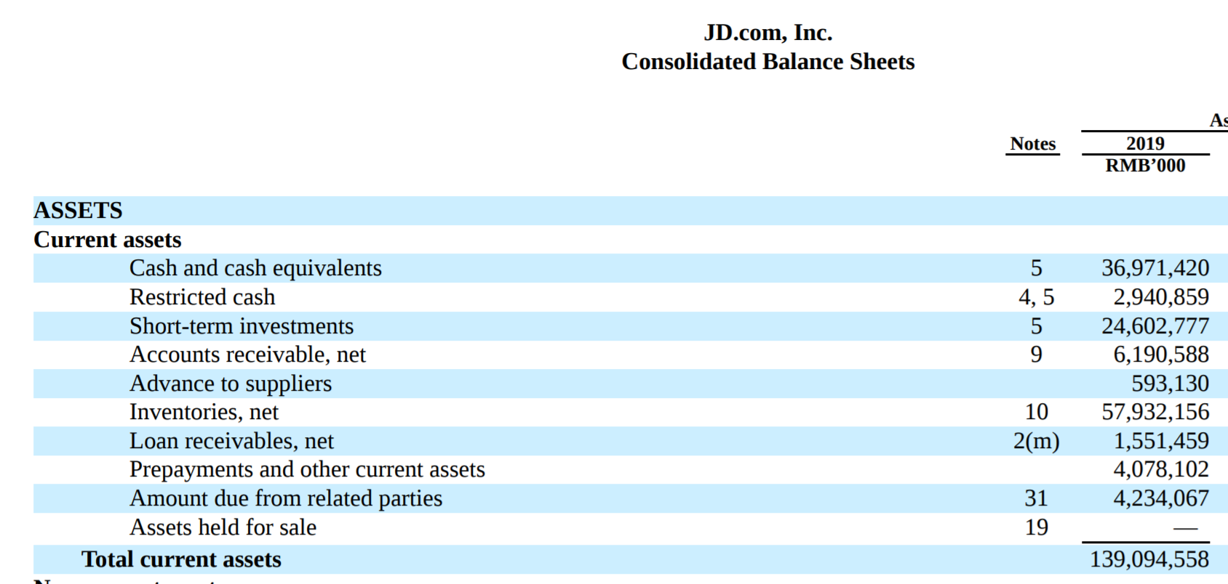
Classification
ILLUSTRATION 8.1
One inventory account.
merchandise inventory 库存商品
Purchase merchandise in a form ready for sale.
LO 1

Slide 7
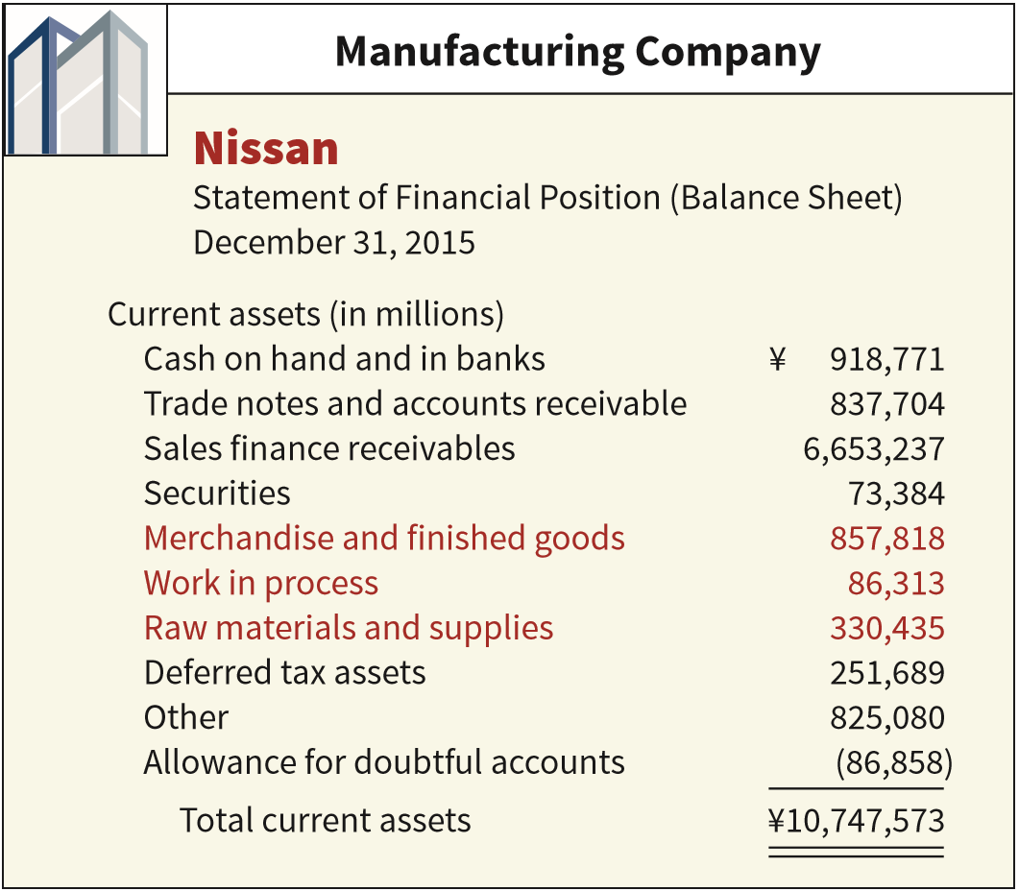
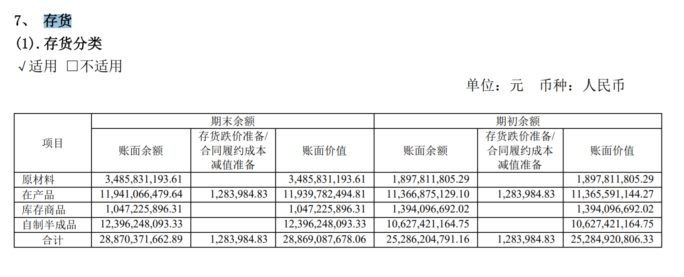
Classification
ILLUSTRATION 8.1
Three accounts
Raw Materials 原材料
Work in Process 在产品
Finished Goods 产成品
LO 1
Notes:
A company reports the cost assigned to goods and materials on hand but not yet placed into production as raw materials inventory. These materials can be traced directly to the end product.
At any point in a continuous production process, some units are only partially processed. The cost of the raw material for these unfinished units, plus the direct labor cost applied specifically to this material and a ratable share of manufacturing overhead costs, constitute the work in process inventory.
Companies report the costs identified with the completed but unsold units on hand at the end of the fiscal period as finished goods inventory

Slide 8
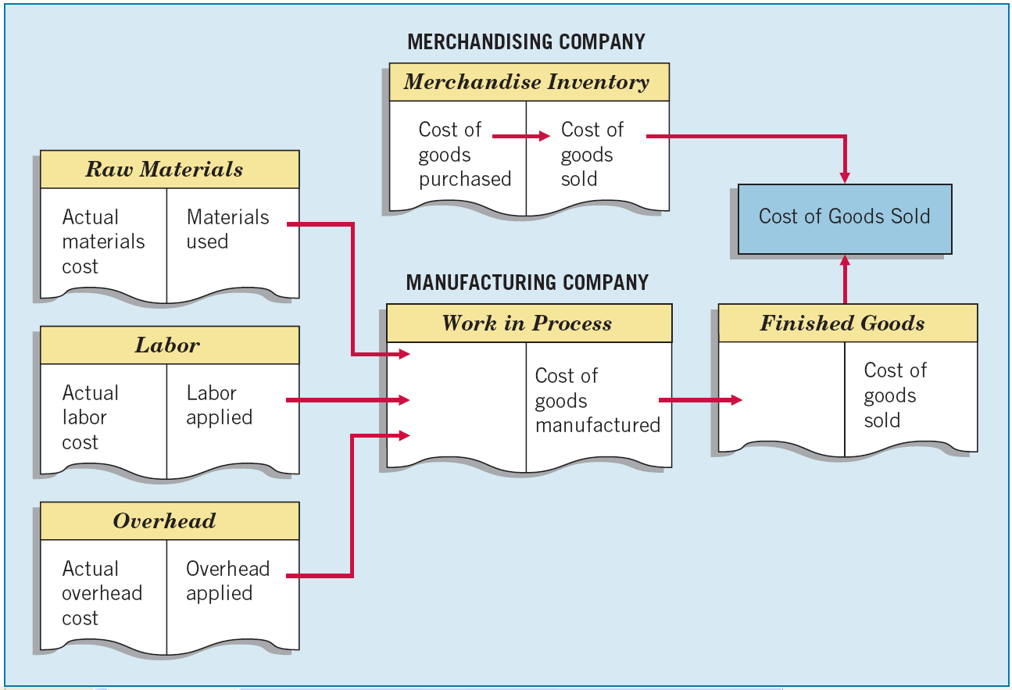
ILLUSTRATION 8.2
Flow of Costs through Manufacturing and Merchandising Companies
LO 1

Slide 9
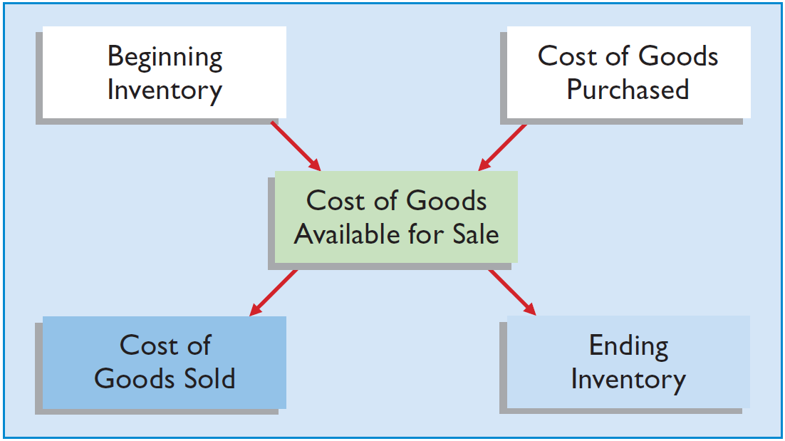
Inventory Issues
Inventory Cost Flow
ILLUSTRATION 8.3
Two types of systems for maintaining inventory records — perpetual system or periodic system.
LO 1
Notes:
Companies that sell or produce goods report inventory and cost of goods sold at the end of each accounting period.
Companies that sell or produce goods report inventory and cost of goods sold at the end of each accounting period. The flow of costs for a company is as follows. Beginning inventory plus the cost of goods purchased is the cost of goods available for sale. As goods are sold, they are assigned to cost of goods sold. Those goods that are not sold by the end of the accounting period represent ending inventory. Illustration 8.3 shows these relationships.

Slide 10
Inventory Cost Flow
Perpetual System 永续盘存制
Purchases of merchandise/or raw materials for production are debited to Inventory 存货.
Freight-in is debited to Inventory 存货. Purchase returns and allowances and purchase discounts are credited to Inventory 存货.
Cost of goods sold 主营业务成本 is debited and Inventory 存货 is credited for each sale.
Subsidiary records show quantity and cost of each type of inventory on hand.
The perpetual inventory system provides a continuous record of the balance in both the Inventory and Cost of Goods Sold accounts.
LO 1
Notes:
Inventory records may be maintained on a perpetual or periodic inventory system basis. A perpetual inventory system provides a means for generating up-to-date records related to inventory quantities. Under this inventory system, data are available at any time relative to the quantity of material or type of merchandise on hand. In a perpetual inventory system, purchases and sales of goods are recorded directly in the Inventory account as they occur. A Cost of Goods Sold account is used to accumulate the issuances from inventory. The balance in the Inventory account at the end of the year should represent the ending inventory amount.
A perpetual inventory system continuously tracks changes in the Inventory account.
A perpetual inventory system continuously tracks changes in the Inventory account. That is, a company records all purchases and sales (issues) of goods directly in the Inventory account as they occur.
The perpetual inventory system provides a continuous record of the balances in both the Inventory account and the Cost of Goods Sold account.

Slide 11
Inventory Cost Flow
Periodic System 定期盘存制
Purchases of merchandise are debited to Purchases 物资采购.
Ending Inventory determined by physical count 存货盘点.
Calculation of Cost of Goods Sold:
Beginning inventory $ 100,000
Purchases, net + 800,000
Goods available for sale 900,000
Ending inventory - 125,000 (Physical count)
Cost of goods sold $ 775,000
LO 1
Notes:
Under a periodic inventory system, a company determines the quantity of inventory on hand only periodically, as the name implies.
When the inventory is accounted for on a periodic inventory system, the acquisition of inventory is debited to a Purchases account. The cost of goods sold must be calculated when a periodic inventory system is in use. The computation of cost of goods sold is made by adding beginning inventory to net purchases and then subtracting ending inventory. Ending inventory is determined by a physical count at the end of the year under a periodic inventory system.
Even in a perpetual inventory system, a physical inventory count at year-end is normally taken due to the potential for loss, error, or shrinkage of inventory during the year.
Note that under a periodic inventory system, the cost of goods sold is a residual amount that depends on a physical count of ending inventory.

Slide 12
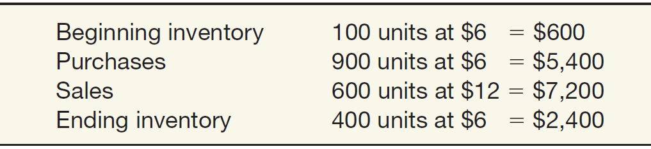
Inventory Cost Flow
Comparing Perpetual and Periodic Systems
Illustration: Fesmire Company had the following transactions during the current year.
Record these transactions using the Perpetual and Periodic systems.
LO 1

Slide 13
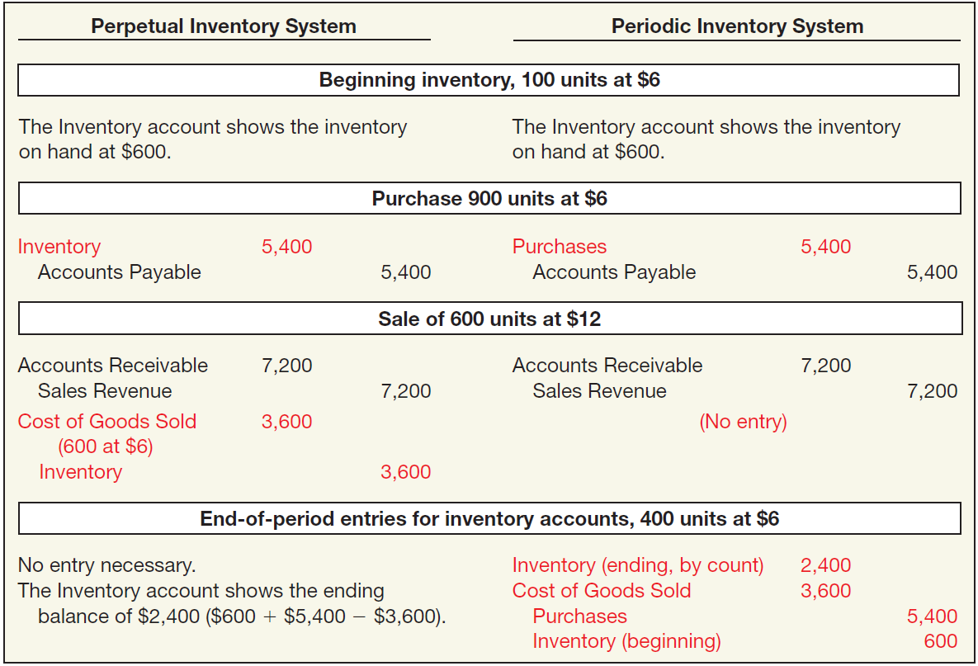

Inventory Cost Flow
ILLUSTRATION 8.4
Comparative Entries—
Perpetual vs. Periodic
账户名Account | 借 Debit | 贷 Credit
账户名Account | 借 Debit | 贷 Credit
LO 1

Slide 14
Inventory Cost Flow
ILLUSTRATION 8.4
Comparative Entries—
Perpetual vs. Periodic
账户名Account | 借 Debit | 贷 Credit
账户名Account | 借 Debit | 贷 Credit
存货
物资采购
应付账款
应付账款
应收帐款
应收帐款
主营业务收入
主营业务收入
主营业务成本
存货
存货
主营业务成本
物资采购
存货
LO 1

Slide 15
Inventory Cost Flow
Illustration: Assume that at the end of the reporting period, the perpetual inventory account reported an inventory balance of $4,000. However, a physical count indicates inventory of $3,800 is actually on hand. The entry to record the necessary write-down is as follows.
Inventory Over and Short 200
待处理财产损溢——存货盘亏和盘盈
Inventory 存货 200
Note: Inventory Over and Short adjusts Cost of Goods Sold. In practice, companies sometimes report Inventory Over and Short in the “Other income and expense” section of the income statement.
LO 1
Notes:
When a company uses a perpetual inventory system and a difference exists between the perpetual inventory balance and the physical inventory count, it needs a separate entry to adjust the perpetual inventory account.
Perpetual inventory overages and shortages generally represent a misstatement of cost of goods sold. The difference results from normal and expected shrinkage, breakage, shoplifting, incorrect recordkeeping, and the like.
Note that a company using the periodic inventory system does not report the account Inventory Over and Short. The reason: The periodic method does not have accounting records against which to compare the physical count. As a result, a company buries inventory overages and shortages in cost of goods sold.
Inventory Over and Short 待处理财产损益

Slide 16
Inventory Issues
Inventory Control
All companies need periodic verification of the inventory records
by actual count, weight, or measurement, with
counts compared with detailed inventory records.
Companies should take the physical inventory
near the end of their fiscal year,
to properly report inventory quantities in their annual accounting reports.
LO 1
Notes:
Inventory planning and control is of vital importance to the success of a merchandising or manufacturing concern. If an excessive amount of inventory is accumulated, there is the danger of loss owing to obsolescence. If the supply of inventory is inadequate, the potential for lost sales exists. This dilemma makes inventory an asset to which manage­ment must devote a great deal of attention.
In a perfect world, companies would like a continuous record of both their inventory levels and their cost of goods sold. The popularity and affordability of accounting software make the perpetual system cost-effective for many kinds of businesses.
No matter what type of inventory records companies use, they all face the danger of loss and error. Waste, breakage, theft, improper entry, failure to prepare or record requisitions, and other similar possibilities may cause the inventory records to differ from the actual inventory on hand.
Thus, all companies need periodic verification of the inventory records by actual count, weight, or measurement, with the counts compared with the detailed inventory records.
Reconciliation between the recorded inventory amount and the actual amount of inventory on hand is normally performed at least once a year. This is called a physical inventory and involves counting all inventory items and comparing the amount counted with the amount shown in the detailed inventory records. Any errors in the records are corrected to agree with the physical count.

Slide 17
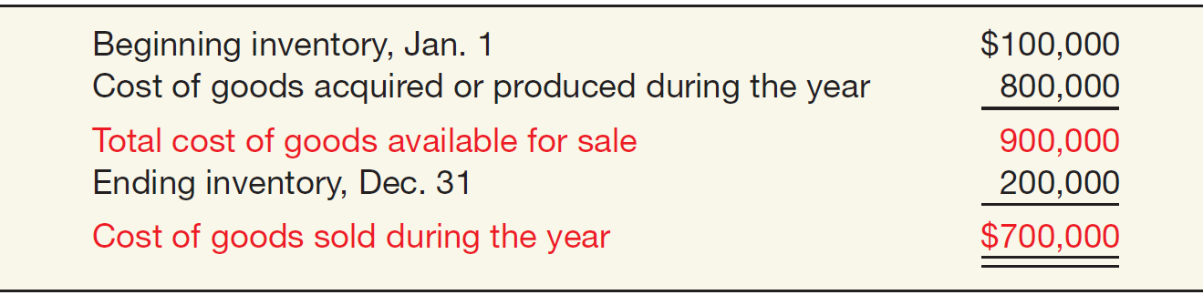
Inventory Issues
Determining Cost of Goods Sold
Companies must allocate the cost of all the goods available for sale (or use) between the goods that were sold or used and those that are still on hand.
ILLUSTRATION 8.5
Computation of Cost
of Goods Sold
LO 1
Notes:
The cost of goods sold during any accounting period is defined as all the goods available for sale during the period less any unsold goods on hand at the end of the period (ending inventory). The process of computing cost of goods sold is complicated by the determination of (a) the physical goods to be included in inventory, (b) the costs to be included in inventory, and (c) the cost flow assumption to be used.

Slide 18
单选题
1分
Quick Check #1
Which of the following would not be included in a manufacturing company's balance sheet?
此题未设置答案，请点击右侧设置按钮
A
Finished goods inventory
B
Merchandise inventory
C
Raw materials inventory
D
Work in process inventory
Submit

Slide 19
单选题
1分
Quick Check #2
Under a periodic inventory system,
此题未设置答案，请点击右侧设置按钮
A
inventory over and short is reported.
B
purchases of inventory are recorded in an inventory account.
C
cost of goods sold is determined with every sale.
D
cost of goods sold is a residual amount.
Submit

Slide 20
单选题
1分
Quick Check #3
Under a perpetual inventory system, which accounts are debited each time a sale on account is made?
此题未设置答案，请点击右侧设置按钮
A
Accounts Payable and Purchases
B
Accounts Receivable and Cost of Goods Sold
C
Inventory and Cost of Goods Sold
D
Accounts Receivable and Purchases
Submit

Slide 21
单选题
1分
此题未设置答案，请点击右侧设置按钮
Quick Check #4
FBS Corporation uses the perpetual inventory method and the gross method for recording purchases on account. On May 11, it purchased $44,000 of inventory, terms 2/10, n/30. On May 13, FBS returned goods that cost $4,000. On May 19, FBS paid the supplier. On May 19, the company should credit
A
Purchase Discounts for $880.
B
Inventory for $880.
C
Purchase Discounts for $800.
D
Inventory for $800.
Submit

Slide 22
LEARNING OBJECTIVE 2
Identify the goods and costs included in inventory.

Slide 23
Goods and Costs Included an Inventory
Goods Included in Inventory
A company recognizes inventory 存货 and accounts payable 应付账款 at the time it controls the asset.
Passage of title is often used to determine control because the rights and obligations are established legally.
LO 2
Notes:
Normally, goods are included in inventory when they are received from the supplier. However, at the end of the period, proper accounting requires that all goods to which the company has legal title be included in ending inventory.
A company recognizes inventory and accounts payable at the time it controls the asset.
Control is therefore the key factor in determining when purchases and sales of a product are recognized.

Slide 24
Goods Included In Inventory
Goods in Transit 在途物资
Example: LG (KOR) determines ownership by applying the “passage of title” rule.
If a supplier ships goods to LG f.o.b. shipping point, title passes to LG when the supplier delivers the goods to the common carrier, who acts as an agent for LG.
If the supplier ships the goods f.o.b. destination, title passes to LG only when it receives the goods from the common carrier.
“Shipping point” and “destination” are often designated by a particular location, for example, f.o.b. Seoul.
LO 2
Notes:
Goods in transit at the end of the period, shipped f.o.b. shipping point, should be included in the buyer’s ending inventory. If goods are shipped f.o.b. destination, they belong to the seller until received by the buyer.
When LG obtains legal title to goods, it must record them as purchases in that fiscal period, assuming a periodic inventory system. Thus, goods shipped to LG f.o.b. shipping point, but in transit at the end of the period, belong to LG. It should show the purchase in its records because legal title to these goods passed to LG upon shipment of the goods.

Slide 25
Goods Included In Inventory
Consigned Goods 代销商品
Example: Williams Art Gallery (the consignor) ships various art merchandise to Sotheby’s Holdings (USA) (the consignee), who acts as Williams’ agent in selling the consigned goods.
Sotheby’s agrees to accept the goods without any liability, except to exercise due care and reasonable protection from loss or damage, until it sells the goods to a third party.
When Sotheby’s sells the goods, it remits the revenue, less a selling commission and expenses incurred, to Williams.
Goods out on consignment remain the property of the consignor (Williams).
LO 2
Notes:
Inventory out on consignment belongs to the consignor’s inventory.
Soth‧e‧by's /ˈsʌðəbiz/
Although Sotheby’s has physical possession of the goods, it does not have control because legal title and the risks and rewards of ownership remain with Williams.
The consignee makes no entry to the inventory account for goods received. Remember, these goods remain the property of the consignor until sold

Slide 26
单选题
1分
Quick Check #5
How is a significant amount of consignment inventory reported in the statement of financial position?
此题未设置答案，请点击右侧设置按钮
A
The inventory is reported separately on the consignor's statement of financial position.
B
The inventory is combined with other inventory on the consignor's statement of financial position.
C
The inventory is reported separately on the consignee's statement of financial position.
D
The inventory is combined with other inventory on the consignee's statement of financial position.
Submit
Notes:
Occasionally, and only for a significant amount, the consignor shows the inventory out on consignment as a separate item. Sometimes a consignor reports the inventory on consignment in the notes to the financial statements.

Slide 27
Goods Included In Inventory
Sales with Repurchase Agreements 回购协议
Example: Hill Enterprises transfers (“sells”) inventory to Chase, Inc. and simultaneously agrees to repurchase this merchandise at a specified price over a specified period of time. Chase then uses the inventory as collateral and borrows against it. Chase uses the loan proceeds to pay Hill, which repurchases the inventory in the future.
Essence of transaction is that Hill Enterprises is financing its inventory—and retains control of the inventory—even though it transferred to Chase technical legal title to the merchandise.
Often described in practice as a “parking transaction.”
Hill should report the inventory and related liability on its books.
LO 2
Notes:
As we indicated earlier, transfer of legal title is the general guideline used to determine whether a company should include an item in inventory. Unfortunately, transfer of legal title and the underlying substance of the transaction sometimes do not match. For example, legal title may have passed to the purchaser, but the seller of the goods retains control of the inventory.
Two special sales situations are illustrated here to indicate the types of problems companies encounter in practice:
Sales with repurchase agreement.
Sales with high rates of return.
Special Sale Agreements in which the transfer of legal title may not be accompanied by a transfer of the risks of ownership.
(1) In essence, the “seller” finances the cost of the inventory by transferring legal title to a third party and receiving “payment.” The “seller” then agrees to “buy” the inventory back at a specified price over a specified future period.
(2) These transactions are often referred to as “parking transactions” because the seller simply parks the inventory on another firm’s statement of financial position and uses it as a financing device.
(3) In these arrangements, the inventory and related liability from the repurchase agreement should remain on the “seller’s” books. No sale should be recorded.

Slide 28
Goods Included In Inventory
Sales with Rights of Return 退货权
Example: Quality Publishing Company sells textbooks to Campus Bookstores with an agreement that Campus may return for full credit any books not sold. Historically, Campus Bookstores returned approximately 25 percent of the textbooks from Quality Publishing. Quality Publishing should recognize
Record sales revenue at the amount it expects to receive from the transaction. This transaction involves variable consideration and therefore the transaction price is adjusted to recognize that a portion of these textbooks will be returned.
Establish an estimated inventory return 应收退货成本 account to recognize that some of its textbooks will be returned. The reason for recording estimated inventory is that control over a significant number of the textbooks has not passed to Campus Bookstore.
If Quality Publishing is unable to estimate the level of returns, it should not report any revenue until the returns become predictive.
LO 2
Notes:
In other words, control does pass from seller to buyer for a majority of the textbooks but not all of them. Quality Publishing therefore records an estimated inventory return amount to recognize that fact.
estimated inventory return 应收退货成本
Estimated return 预计负债——应付退货款

Slide 29
Costs Included In Inventory
Product Costs 产品成本
Costs directly connected with bringing the goods to the buyer’s place of business and converting such goods to a salable condition.
Cost of purchase 采购成本 includes all of:
The purchase price.
Import duties and other taxes.
Transportation costs.
Handling costs directly related to the acquisition of the goods.
LO 2
Notes:
Companies generally account for the acquisition of inventories, like other assets, on a cost basis.
These costs are directly connected with bringing the goods to the buyer’s place of business and converting such goods to a salable condition. Such charges generally include (1) costs of purchase, (2) costs of conversion, and (3) “other costs” incurred in bringing the inventories to the point of sale and in salable condition.
Conversion costs for a manufacturing company include direct materials, direct labor, and manufacturing overhead costs. Manufacturing overhead costs include indirect materials, indirect labor, and various costs, such as depreciation, taxes, insurance, and utilities
“Other costs” include those incurred to bring the inventory to its present location and condition ready to sell, such as the cost to design a product for specific customer needs.

Slide 30
Costs Included In Inventory
Product Costs 产品成本
Costs directly connected with bringing the goods to the buyer’s place of business and converting such goods to a salable condition.
Costs of Conversion 加工成本 includes all of:
Direct materials. 直接材料
Direct labor. 直接人工
Manufacturing overhead costs 制造费用: indirect materials, indirect labor, and various costs, such as depreciation, taxes, insurance, and utilities.
Other costs 其他成本include those incurred to bring the inventory to its present location and condition ready to sell, such as the cost to design a product for specific customer needs.
LO 2
Notes:
These costs are directly connected with bringing the goods to the buyer’s place of business and converting such goods to a salable condition. Such charges generally include (1) costs of purchase, (2) costs of conversion, and (3) “other costs” incurred in bringing the inventories to the point of sale and in salable condition.
Conversion costs for a manufacturing company include direct materials, direct labor, and manufacturing overhead costs. Manufacturing overhead costs include indirect materials, indirect labor, and various costs, such as depreciation, taxes, insurance, and utilities
“Other costs” include those incurred to bring the inventory to its present location and condition ready to sell, such as the cost to design a product for specific customer needs.

Slide 31
Costs Included In Inventory
Period Costs 期间费用
Costs that are indirectly related to the acquisition or production of goods.
Period costs such as
selling expenses 销售费用 and,
general and administrative expenses 管理费用
are not included as part of inventory cost.
How about interest costs? 财务费用
The IASB ruled that companies should capitalize interest costs related to assets constructed for internal use or assets produced as discrete projects (such as ships or real estate projects) for sale or lease.
Notes:
Because companies generally consider selling expenses as more directly related to the cost of goods sold than to the unsold inventory.
In addition, period costs, especially administrative expenses, are so unrelated or indirectly related to the immediate production process that any allocation is purely arbitrary

Slide 32
单选题
1分
此题未设置答案，请点击右侧设置按钮
Quick Check #6
Which of the following is correct?
A
Selling costs are product costs.
B
Manufacturing overhead costs are product costs.
C
Interest costs for routine inventories are product costs.
D
All of these are correct.
Submit
Notes:
Interest is another period cost. Companies usually expense interest costs associated with getting inventories ready for sale.
The IASB ruled that companies should capitalize interest costs related to assets constructed for internal use or assets produced as discrete projects (such as ships or real estate projects) for sale or lease. The IASB emphasized that these discrete projects should take considerable time, entail substantial expenditures, and be likely to involve significant amounts of interest cost
Thus, a company should not capitalize interest costs for inventories that it routinely manufactures or otherwise produces in large quantities on a repetitive basis.

Slide 33
单选题
1分
Quick Check #7
Costs which are inventoriable include all of the following except
此题未设置答案，请点击右侧设置按钮
A
costs that are directly connected with the bringing of goods to the place of business of the buyer.
B
costs that are directly connected with the converting of goods to a salable condition.
C
buying costs of a purchasing department.
D
selling costs of a sales department.
Submit

Slide 34
Costs Included In Inventory
Treatment of Purchase Discounts 采购折扣
Purchase or trade discounts are reductions in the selling prices granted to customers.
IASB requires these discounts to be recorded as a reduction from the cost of inventories.
LO 2

Slide 35
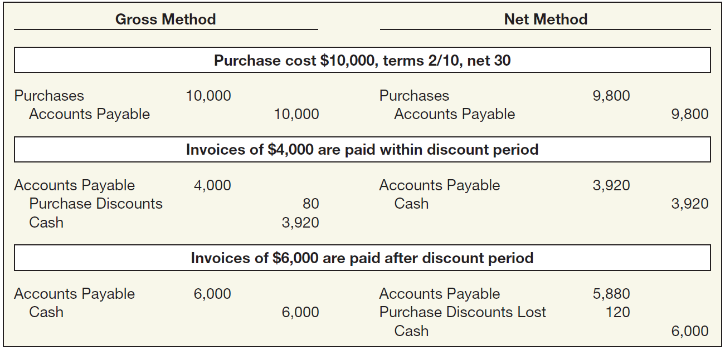
Treatment of Purchase Discounts in a periodic inventory system
账户名Account | 借 Debit | 贷 Credit
账户名Account | 借 Debit | 贷 Credit
**
*
ILLUSTRATION 8.6
Entries under Gross and
Net Methods
* $4,000 x 2% = $80
** $10,000 x 98% = $9,800
LO 2
Notes:
Periodic inventory system
When purchases are recorded net of discounts, failure to pay within the discount period results in the treatment of lost discounts as a financial expense. If the gross method is used, purchase discounts should be reported as a deduction from purchases on the income statement. If the net method is used, purchase discounts lost should be con­sidered a financial expense and reported in the “other income and expense” section of the income statement.
If a company uses this net method, it considers purchase discounts lost as a financial expense and reports it in the “Other income and expense” section of the income statement. This treatment is considered better for two reasons. (1) It provides a correct reporting of the cost of the asset and related liability and (2) It can measure management inefficiency by holding management responsible for discounts not taken.

Slide 36
Treatment of Purchase Discounts
账户名Account | 借 Debit | 贷 Credit
账户名Account | 借 Debit | 贷 Credit
物资采购
物资采购
**
应付账款
应付账款
应付账款
应付账款
购货折扣
*
现金
现金
应付账款
应付账款
现金
购货折扣损失
现金
ILLUSTRATION 8.6
Entries under Gross and
Net Methods
* $4,000 x 2% = $80
** $10,000 x 98% = $9,800
LO 2
Notes:
Periodic inventory system
When purchases are recorded net of discounts, failure to pay within the discount period results in the treatment of lost discounts as a financial expense. If the gross method is used, purchase discounts should be reported as a deduction from purchases on the income statement. If the net method is used, purchase discounts lost should be con­sidered a financial expense and reported in the “other income and expense” section of the income statement.
If a company uses this net method, it considers purchase discounts lost as a financial expense and reports it in the “Other income and expense” section of the income statement. This treatment is considered better for two reasons. (1) It provides a correct reporting of the cost of the asset and related liability and (2) It can measure management inefficiency by holding management responsible for discounts not taken.

Slide 37


感谢您的参与！
THE HITSZ
SCHOOL OF ECONOMICS
AND MANAGEMENT

